Slide 1

GHANA COMMUNICATION TECHNOLOGY UNIVERSITY
FACULTY OF ENGINEERING
DEPARTMENT OF COMPUTER ENGINEERING
DEVELOPMENT AND IMPLEMENTATION OF A ROBOTIC APPLICATION FOR HUMAN INTENTION RECOGNITION USING MOTION AND HAND GESTURE
A Final Project Report Submitted in Partial Fulfillment of the Requirements for the Degree of BSc. Computer Engineering
PRESENTED BY:
ELEANA OSEI OWUSU — 4121230024
JOEL NII ADJETEY AHULU — 4121230020
SUPERVISOR: MR. MICHEAL XENYA

Slide 2
PRESENTATION OUTLINE
01. INTRODUCTION & PROBLEM CONTEXT
• Motivation, Problem Statement, Objectives & ERQs
02. LITERATURE REVIEW & RESEARCH GAPS
• Benchmark Studies (Tsitos, Mahmud, Li) & The Central Gap
03. SYSTEM ARCHITECTURE & METHODOLOGY
• Mechatronic Hardware, 19-D Feature MLP, LSTM, Nav2/SLAM
04. EXPERIMENTAL VALIDATION & RESULTS
• Latency Budget (<75 ms), Confusion Matrix & Locomotion Trials
05. CONCLUSION & RECOMMENDATIONS
• Summary of Contributions, ISO 15066 Compliance & Demonstration

Slide 3
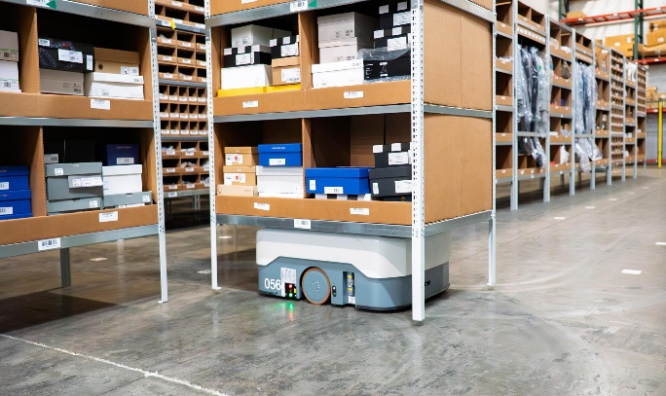
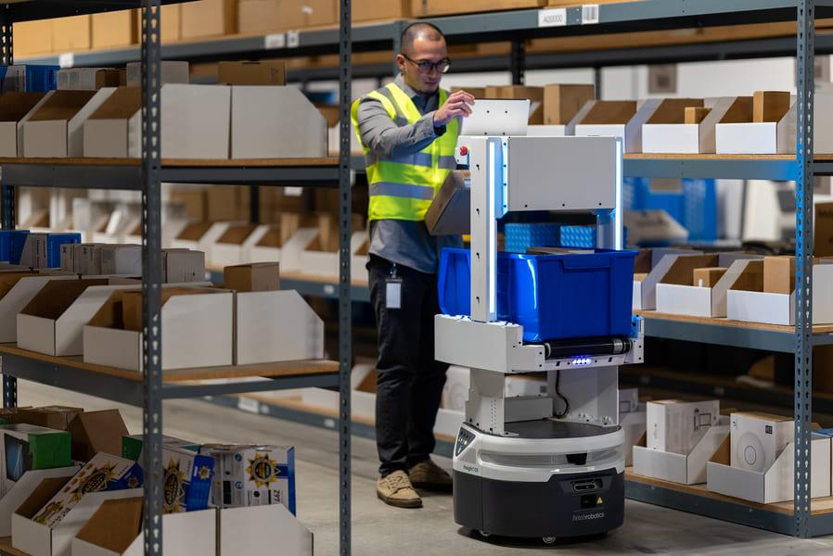
INTRODUCTION
Human–Robot Interaction (HRI) enables robots to understand and respond to human actions.
Gestures and body movements provide natural, contactless control.
Vision-based systems can require high computing power..
Edge computing supports real-time processing on low-power robots.
This project combines intention recognition, environmental awareness, and navigation.
Figure 1: Autonomous Mobile Robot Performing Navigation Tasks
Figure 2: Human Interaction with an Autonomous Mobile Robot Interface

Slide 4
Problem Statement
• High-Power Hardware & Cloud Latency: Offboard cloud vision introduces unpredictable latency (>200 ms) and connection drops, violating real-time robotic safety reaction limits (Tsitos et al., 2022).
• Spatial Distance Domain Shift: Classifiers evaluating raw pixel coordinates degrade as operator distance varies (1.0m to 2.5m) due to optical perspective scaling.
• Ungrounded Spatial Command Execution: Executing recognized gestures blindly without continuous 360° laser mapping and obstacle verification presents severe collision hazards in shared indoor workspaces.
• Collaborative Safety Compliance: International standards (ISO 15066:2016) mandate speed and separation monitoring, requiring guaranteed deterministic halting distances (<0.45m).

Slide 5
OBJECTIVES
General Objective:
To design, implement and evaluate an edge-based real-time human intention recognition system integrating hand gestures and autonomous navigation using ROS 2.
Specific Objectives:
• To design and implement an edge-optimized vision pipeline using 19 scale-invariant geometric hand features.
• To construct and balance a custom 6,000-sample gesture dataset captured directly through the onboard camera.
• To develop an LSTM sequential recurrent model for short-horizon human trajectory prediction.
• To implement a deterministic supervisory decision node (brain_node) with rolling consensus and visual servoing.
• To configure and validate LiDAR SLAM and Nav2 autonomous navigation for collision-free trajectory execution.
• To quantitatively evaluate latency budgets (<150 ms), classification accuracy, and real-time physical throughput.

Slide 6
SIGNIFICANCE OF THE STUDY
RESEARCH GAPS
Existing systems often treat recognition and navigation separately.
Some systems depend on cloud or powerful GPUs.
Some lack environmental awareness.
Few combine intention recognition with navigation.
his study integrates these functions on an edge robot
Reduces dependence on cloud computing.
Enables contactless robot control.
Supports industrial and healthcare applications.
Improves human–robot interaction.
Enables AI processing on edge devices

Slide 7
LITERATURE REVIEW
Ref / Year | Author(s) | Topic | Objectives | Methodology | Identified Gaps
[1] 2022 | Tsitos et al. | Real-time Feasibility of a Human Intention Method Evaluated Through a Competitive Human-Robot Reaching Game | Predict human intention in real time using a single RGB-D camera. | OpenPose, RGB-D camera, ML models, ROS, UR3 robot. | Stationary UR3 arm without mobile base navigation or explicit gesture command channel.
[2] 2022 | Mahmud et al. | 3D Gesture Recognition and Adaptation for Human–Robot Interaction | Recognize 3D gestures for robot control. | Kinect, HMM, SVM, CNN, robot navigation. | Restricted to proprietary Kinect sensor; navigation evaluated only in simulation without physical latency or wheel slip.
[3] 2023 | Yang et al. / Li et al. | Safe and Efficient Motion Planning for Material Transportation Robots Considering Intention Prediction of Obstacles | Predict obstacle intentions for safe navigation. | Object detection, ReLU intention model, Nav2, ROS2. | Simulation only (Isaac Sim); predicts obstacle clearance but lacks touchless human supervisory control.

Slide 8
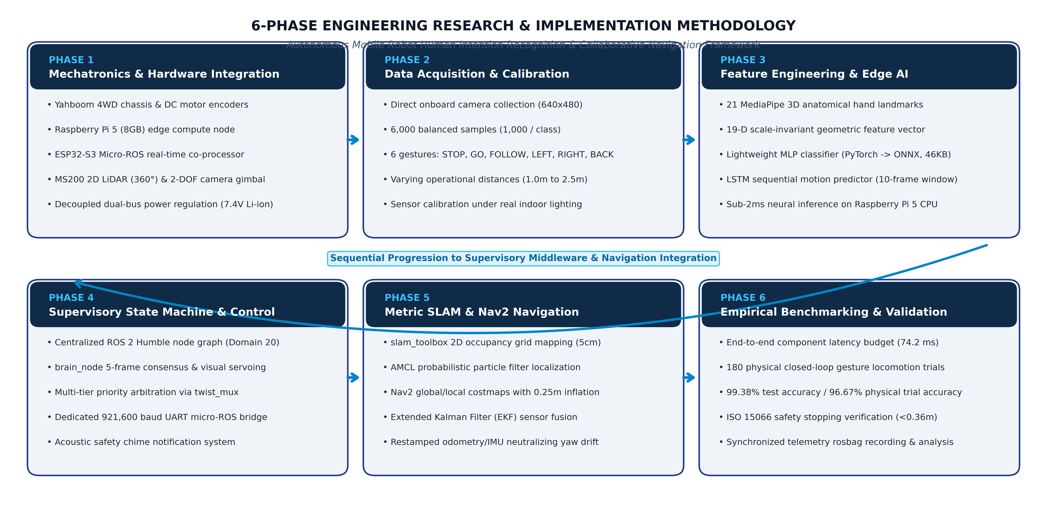
SYSTEM DESIGN & ENGINEERING METHODOLOGY

Slide 9
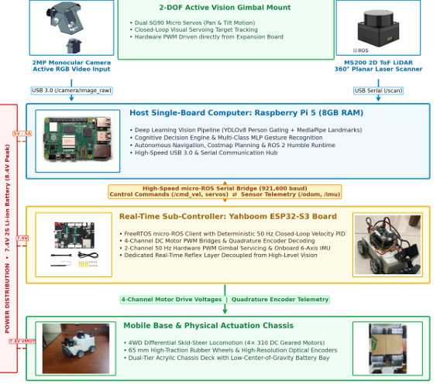
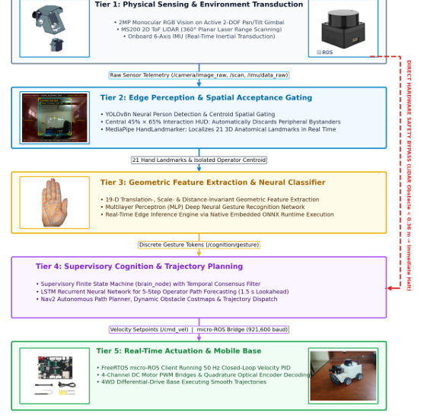
SYSTEM ARCHITECTURE
Figure 3: Hardware Architecture and Signal Distribution
Figure 4: System Architecture

Slide 10
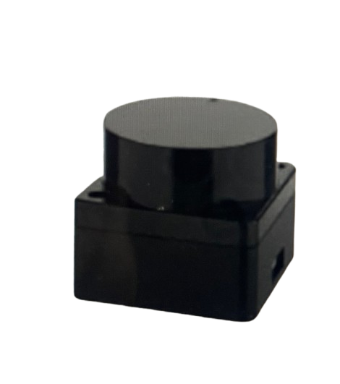
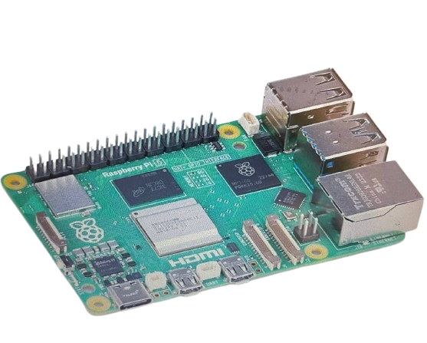
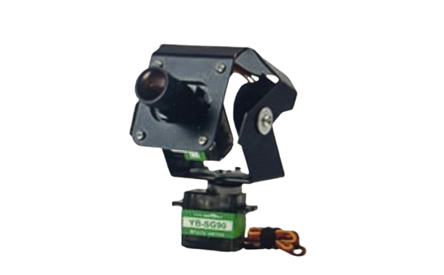
HARDWARE COMPONENTS
Figure 5: Raspberry Pi 5 (8GB RAM)
Edge SBC running ROS 2 Humble, MediaPipe, 19-D MLP, and SLAM/Nav2 directly onboard at 28.4 FPS on CPU.
Figure 6: USB Monocular Camera
Captures 640x480 RGB frames at 30 FPS for gesture classification and active gimbal tracking.
Figure 7: MS200 2D Planar LiDAR
Provides 360° laser scans at 10 Hz up to 12m for SLAM and triggers the 0.36m ISO 15066 safety halt.

Slide 11
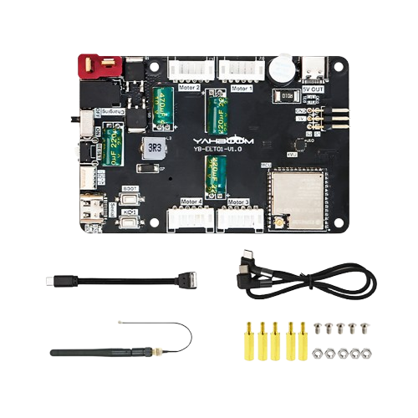

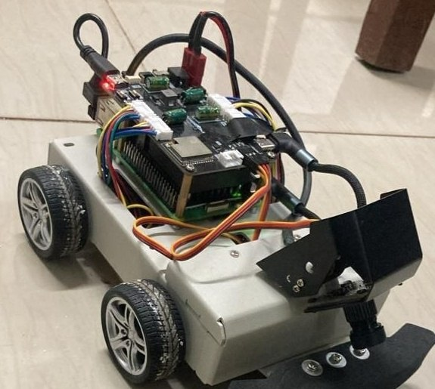
HARDWARE COMPONENTS
Figure 8: Dual-Bus Power Regulation
7.4V 2S Li-ion battery pack with decoupled DC regulation isolating Pi 5 logic from motor current spikes.
Figure 9: Yahboom 4WD Mobile Chassis
Differential-drive chassis with four geared DC motors and optical quadrature encoders.
Figure 10: ESP32-S3 Micro-ROS Co-Processor
Dedicated hard real-time co-processor regulating motor PWM and reading encoders over 921,600 baud UART.

Slide 12
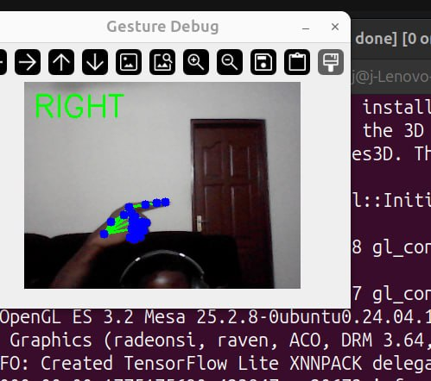
DATASET PREPARATION AND GESTURE RECOGNITION PIPELINE
6,000 samples collected from the robot’s own camera.
6 gesture classes: Stop, Go, Left, Right, Back, Follow.
Balanced dataset: 1,000 samples per gesture.
MediaPipe extracts 21 hand landmarks
Landmarks are converted into 19 normalized geometric features
MLP classifier recognizes the six gestures..
Figure 11:Live System Demonstration: The detected gesture is classified and displayed in real time.

Slide 13
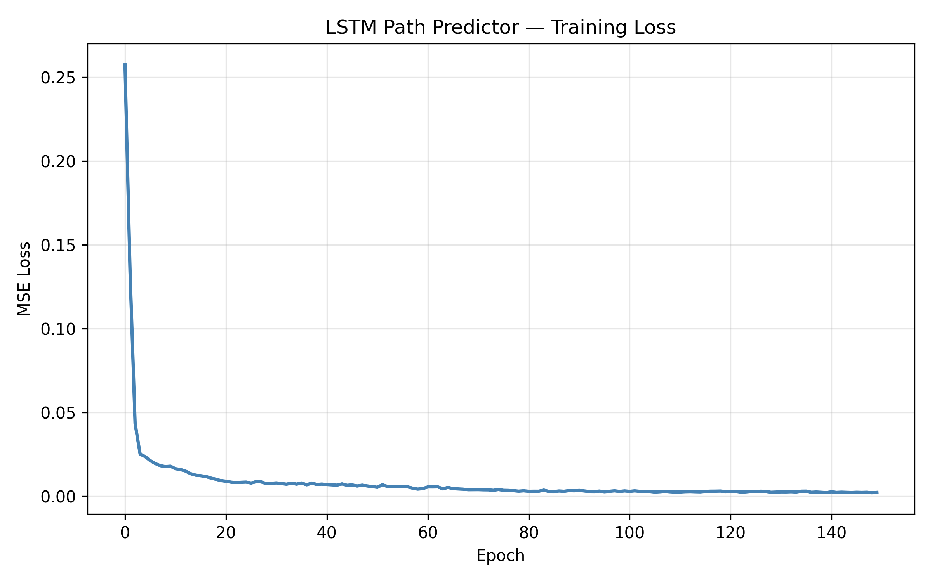
HUMAN MOVEMENT PREDICTION(LSTM)
Uses MediaPipe Pose landmarks to track human movement.
LSTM predicts the operator’s next movement direction.
Uses past movement patterns to anticipate future motion.
Helps the robot respond proactively instead of reactively.
Achieved 25.8 px ADE and 32.4 px FDE.
Figure 13: LSTM Path Predictor Training Loss & Convergence (ADE: 25.8 px, FDE: 32.4 px)

Slide 14

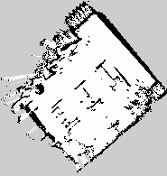
SLAM MAPPING AND LOCALISATION
SLAM Toolbox creates a 2D map using LiDAR and wheel odometry.
The environment is represented as an occupancy grid.
Nav2 enables point-to-point autonomous navigation.
AMCL localizes the robot on the generated map.
Costmaps help the robot avoid unexpected obstacles
Figure 14: Initial SLAM Run — Hourglass Rotational Drift Defect (Unsynchronized IMU Yaw)
Figure 15: Final SLAM Run — Clean 5cm Metric Occupancy Grid Map (EKF Restamping Fix)

Slide 15
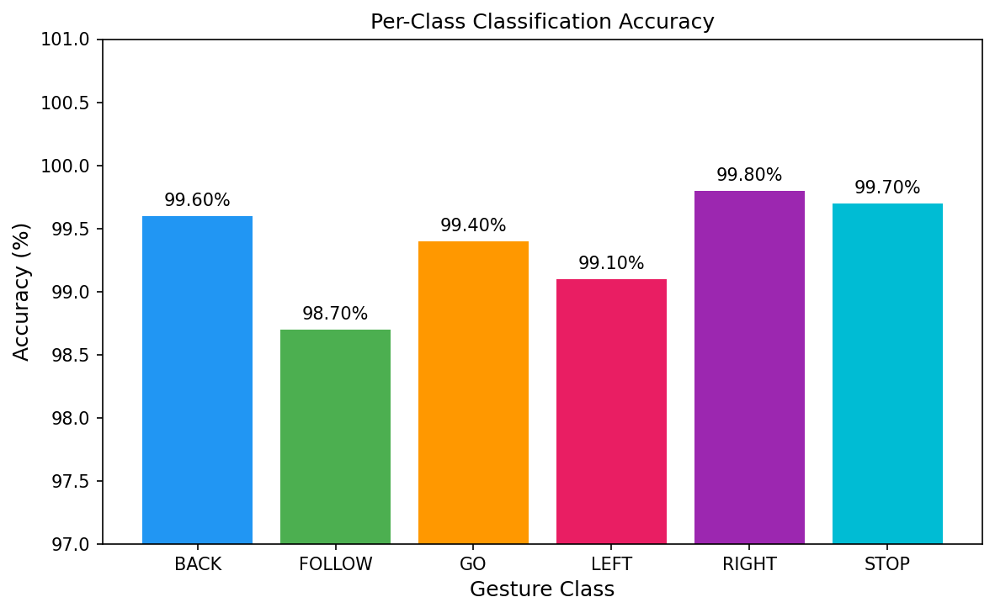
TESTING AND RESULTS
Gesture Recognition Physical Trial Results
Gesture | Total Trials | Successful Trials | Observed Accuracy (%)
Stop | 30 | 27 | 90.0%
Go | 30 | 29 | 96.7%
Follow | 30 | 28 | 93.3%
Left | 30 | 30 | 100.0%
Right | 30 | 30 | 100.0%
Back | 30 | 30 | 100.0%
Aggregate | 180 | 174 | 96.67%
Figure 16: Per-Class Classification Accuracy of the Trained MLP Gesture Model

Slide 16
TESTING AND RESULTS
Movement Recognition Test Results
Movement Class | Observed Kinematic Behavior | Result
Approaching | Rapid expansion of bounding box area with stable center | Successfully Recognized
Moving Away | Continuous contraction of bounding box area with stable center | Successfully Recognized
Moving Left | Persistent leftward centroid translation across frames | Successfully Recognized
Moving Right | Persistent rightward centroid translation across frames | Successfully Recognized
Stationary | Centroid displacement within noise threshold (±4 px) | Successfully Recognized

Slide 17
CONCLUSION AND FUTURE WORKS
Conclusion
Future works
99.38% gesture recognition accuracy.
96.67% physical trial accuracy.
Successful human movement prediction.
ROS 2 integration achieved.
SLAM and Nav2 validated
Real-time edge operation achieved
Safe obstacle detection implemented
Multi-waypoint autonomous navigation.
Proactive human-aware navigation.
Follow-to-Map exploration.
NPU acceleration for AI tasks.
Improved gimbal–chassis control
Multi-sensor safety detection
Larger and more diverse testing.

Slide 18
REFERENCES
[1] D. Tsitos et al., “Real-Time Feasibility of a Human Intention Prediction Method Evaluated Through a Competitive Human–Robot Reaching Game,” IEEE Robotics and Automation Letters, vol. 7, no. 4, pp. 10034–10041, Oct. 2022.
[2] J. A. Mahmud, B. C. Das, J. Shin, K. M. Hasib, R. Sadik, and M. F. Mridha, “3D Gesture Recognition and Adaptation for Human–Robot Interaction,” IEEE Access, vol. 10, pp. 116485–116507, 2022.
[3] G. Yang et al., “Safe and Efficient Motion Planning for Material Transportation Robots Considering Intention Prediction of Obstacles,” in Proc. IEEE Int. Conf. Mechatronics Autom. (ICMA), Harbin, China, 2023, pp. 1179–1184.

Slide 19
Questions & Discussion
Thank You
[ Transition to Live Physical Hardware Demonstration ]

